Slide 1
CHAPTER 2
Number Systems
(Part 1)

Slide 2
Objectives
After studying this chapter, the student should be able to:
Understand the concept of number systems.
Distinguish between non-positional and positional number systems.
Describe the decimal, binary, hexadecimal, and octal system.
Convert a number in binary, octal, or hexadecimal to a number in the decimal system.
Convert a number in the decimal system to a number in binary, octal, and hexadecimal.
Convert a number in binary to octal and vice versa.
Convert a number in binary to hexadecimal and vice versa.
Find the number of digits needed in each system to represent a particular value.

Slide 3
2-1 INTRODUCTION
A number system defines how a number can be represented using distinct symbols. A number can be represented differently in different systems. For example, the two numbers (2A)₁₆ and (52)₈ both refer to the same quantity, (42)₁₀, but their representations are different.
Several number systems have been used in the past and can be categorized into two groups: positional and non-positional systems. Our main goal is to discuss the positional number systems, but we also give examples of non-positional systems.

Slide 4
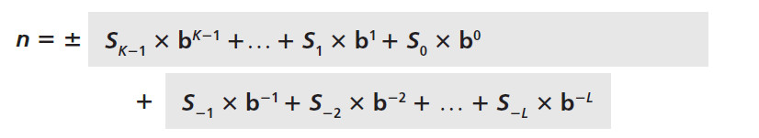
2-2 POSITIONAL NUMBER SYSTEMS
In a positional number system, the position a symbol occupies in the number determines the value it represents. In this system, a number represented as:
has the value of:
in which S is the set of symbols, b is the base (or radix).

Slide 5
2.2.1 The decimal system (base 10)
The word decimal is derived from the Latin root decem (ten). In this system the base b = 10 and we use ten symbols
S = {0, 1, 2, 3, 4, 5, 6, 7, 8, 9}
The symbols in this system are often referred to as decimal digits or just digits.
Examples are: (67)₁₀ and (153)₁₀

Slide 6
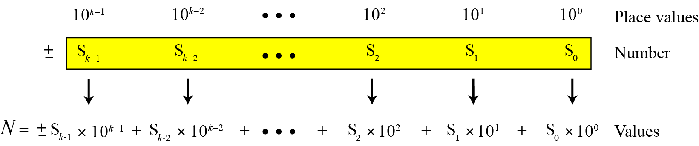
Integers
Figure 2.1 Place values for an integer in the decimal system

Slide 7
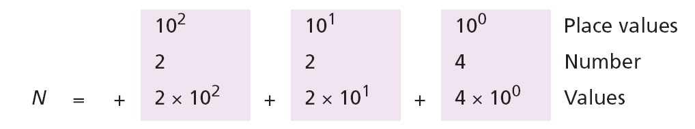
Example 2.1
The following shows the place values for the integer +224 in the decimal system.
Note that the digit 2 in position 1 has the value 20, but the same digit in position 2 has the value 200. Also note that we normally drop the plus sign, but it is implicit.

Slide 8
Example 2.2
The following shows the place values for the decimal number −7508. We have used 1, 10, 100, and 1000 instead of powers of 10.
(
)
Values

Slide 9
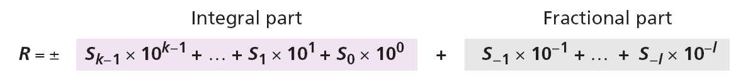
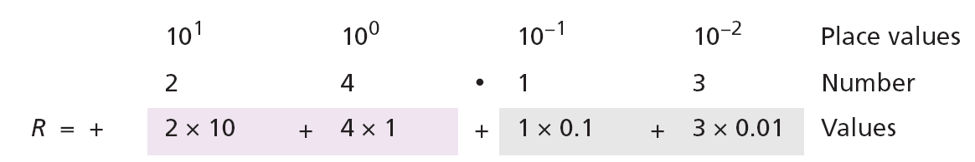
Reals
A real (a number with a fractional part) in the decimal system is also familiar. For example, we use this system to show dollars and cents ($23.40). We can represent a real as
Example 2.3
The following shows the place values for the real number +24.13.

Slide 10
2.2.2 The binary system (base 2)
The word binary is derived from the Latin root bini (or two by two). In this system the base b = 2 and we use only two symbols, S = {0, 1}. The symbols in this system are often referred to as binary digits or bits (binary digit).

Slide 11
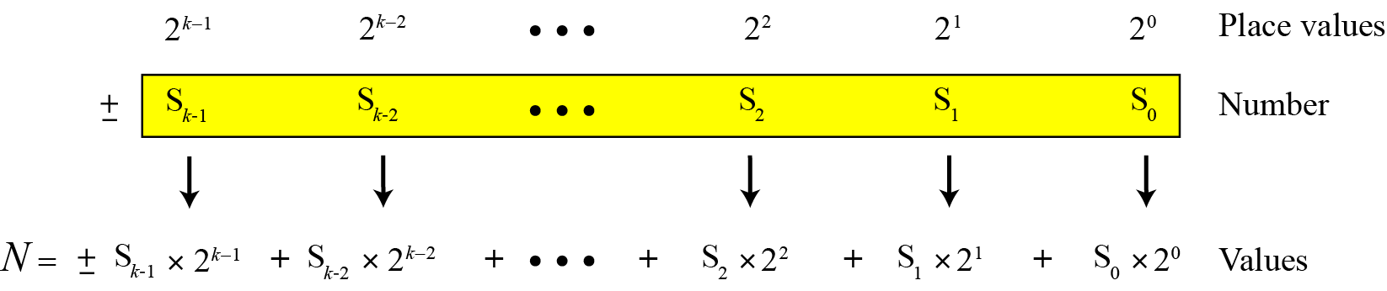
Integers
We can represent an integer as:
Figure 2.2 Place values for an integer in the binary system

Slide 12
Example 2.4
The following shows that the number (11001)₂ in binary is the same as 25 in decimal. The subscript 2 shows that the base is 2.
The equivalent decimal number is N = 16 + 8 + 0 + 0 + 1 = 25.

Slide 13
Reals
A real—a number with an optional fractional part—in the binary system can be made of K bits on the left and L bits on the right:
Example 2.5
The following shows that the number (101.11)₂ in binary is equal to the number 5.75 in decimal.
The value in decimal system is R = 4 + 0 + 1 + 0.5 + 0.25 = 5.75

Slide 14
The hexadecimal system (base 16)
The word hexadecimal is derived from the Greek root hex (six) and the Latin root decem (ten). In this system the base b = 16 and we use sixteen symbols to represent a number. The set of symbols is
S = {0, 1, 2, 3, 4, 5, 6, 7, 8, 9, A, B, C, D, E, F}
Note that the symbols A, B, C, D, E, F are equivalent to 10, 11, 12, 13, 14, and 15 respectively. The symbols in this system are often referred to as hexadecimal digits.

Slide 15
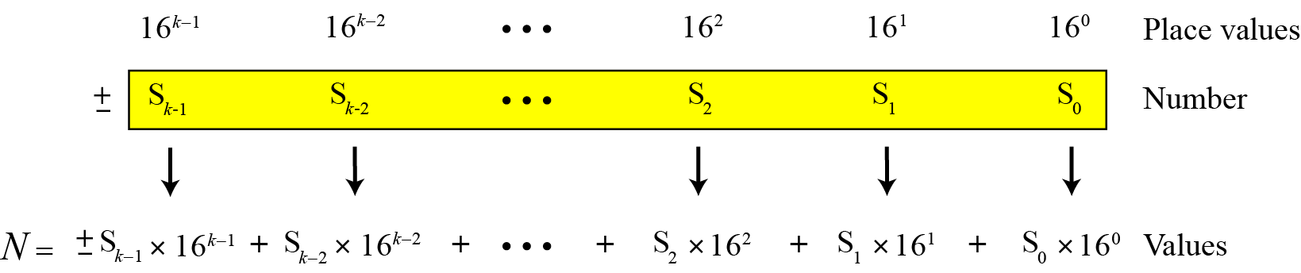
Integers
We can represent an integer as:
Figure 2.3 Place values for an integer in the hexadecimal system

Slide 16
Example 2.6
The following shows that the number (2AE)₁₆ in hexadecimal is equivalent to 686 in decimal.
The equivalent decimal number is N = 512 + 160 + 14 = 686.

Slide 17
2.2.4 The octal system (base 8)
The word octal is derived from the Latin root octo (eight). In this system the base b = 8 and we use eight symbols to represent a number. The set of symbols is
S = {0, 1, 2, 3, 4, 5, 6, 7}

Slide 18
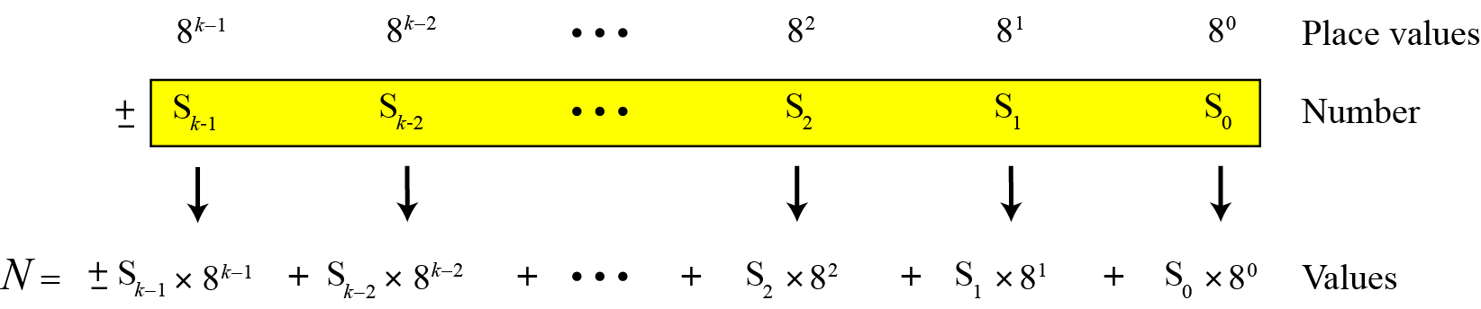
Integers
We can represent an integer as:
Figure 2.3 Place values for an integer in the octal system

Slide 19
Example 2.7
The following shows that the number (1256)₈ in octal is the same as 686 in decimal.
Note that the decimal number is N = 512 + 128 + 40 + 6 = 686.

Slide 20
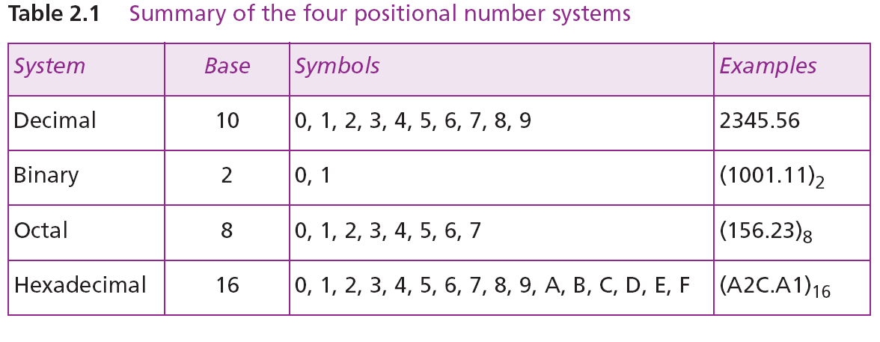
2.2.5 Summary of the four positional systems
Table 2.1 shows a summary of the four positional number systems discussed in this chapter.

Slide 21
Table 2.2 shows how the number 0 to 15 is represented in different systems.

Slide 22
2.2.6 Conversion
We need to know how to convert a number in one system to the equivalent number in another system. Since the decimal system is more familiar than the other systems, we first show how to covert from any base to decimal. Then we show how to convert from decimal to any base. Finally, we show how we can easily convert from binary to hexadecimal or octal and vice versa.

Slide 23
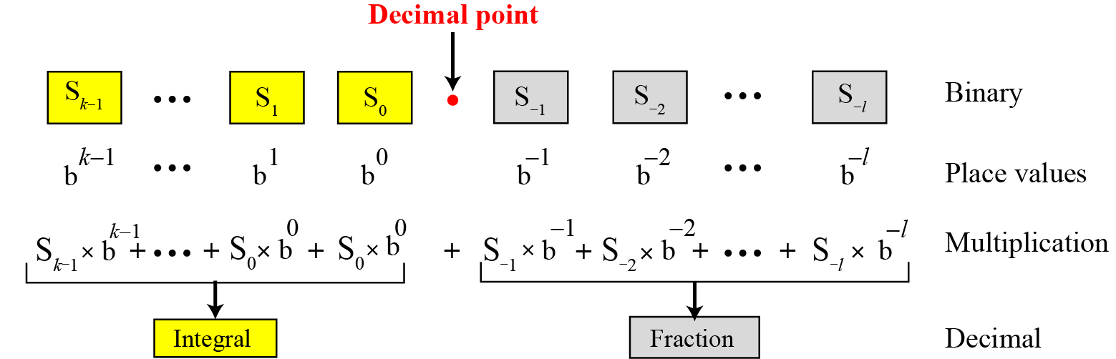
Any base to decimal conversion
Figure 2.5 Converting other bases to decimal

Slide 24
Example 2.8
The following shows how to convert the binary number (110.11)₂ to decimal: (110.11)₂ = 6.75.

Slide 25
Example 2.9
The following shows how to convert the hexadecimal number (1A.23)₁₆ to decimal.
Note that the result in the decimal notation is not exact, because 3 × 16⁻² = 0.01171875. We have rounded this value to three digits (0.012).

Slide 26
Example 2.10
The following shows how to convert (23.17)₈ to decimal.
This means that (23.17)8 ≈ 19.234 in decimal. Again, we have rounded up 7 × 8⁻² = 0.109375.

Slide 27

The End

